Slide 1
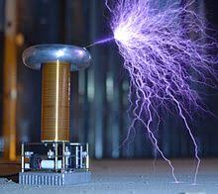


Slide 2

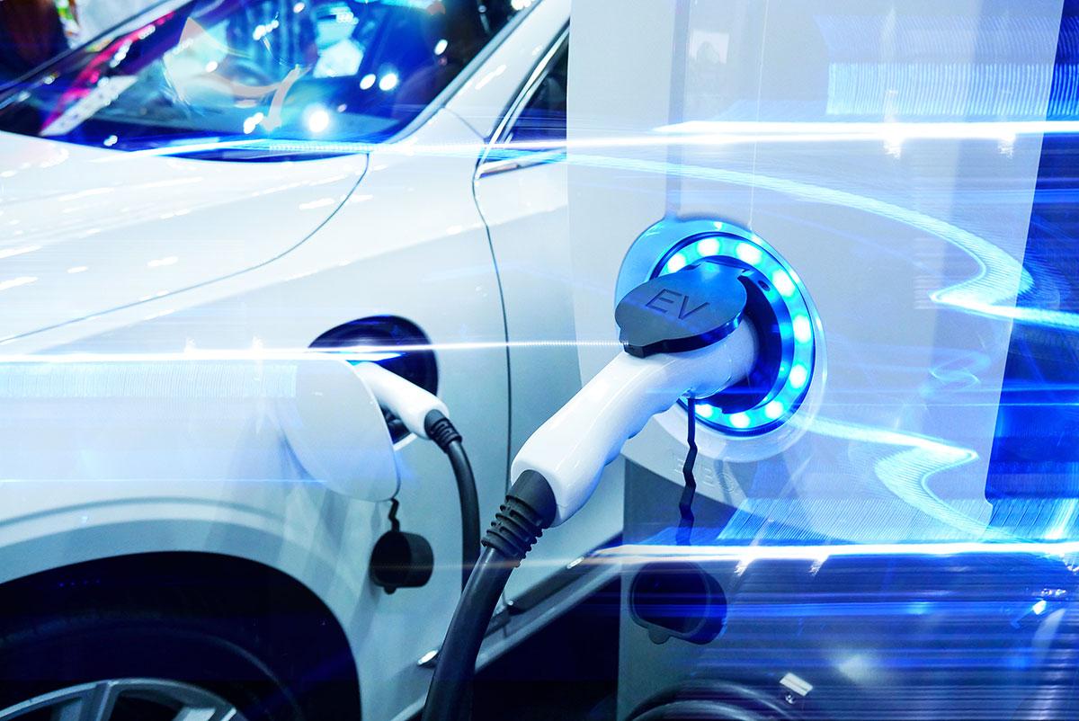
team Members: Nghia NGUYEN TREVOR KLEINSTUBER JAY SUENO CHARLIE MARTINEZ
OUTLINE
PROCESS
DATA DEVELOPMENT
FINDINGS/VISUALS

Slide 3
Process
Data Sets
Electric Vehicles
Electric Stations
Data Cleansing
Converted Json to CSV
Architecture for DB
Flask App
Integrated
Geo Json
HTML
DB
JavaScript

Slide 4
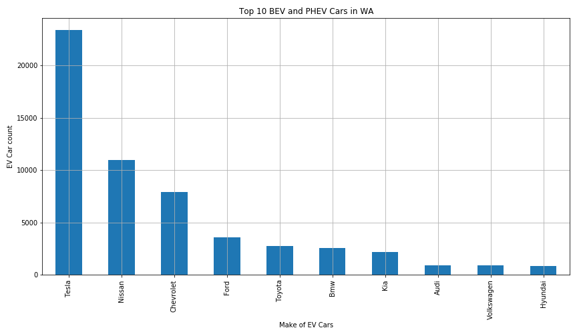
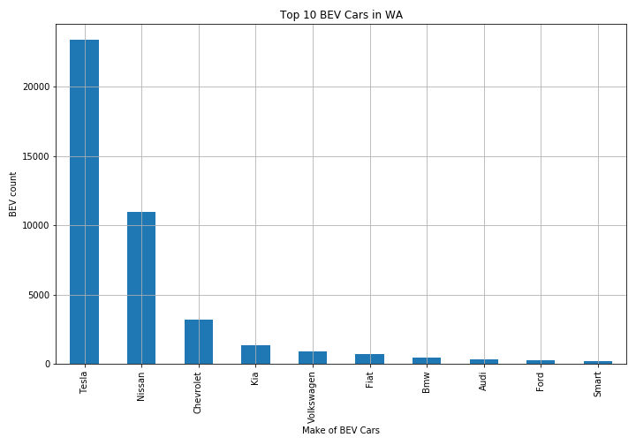
OUR STORY

Slide 5
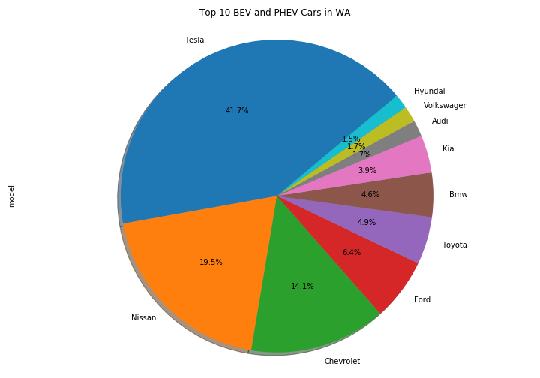
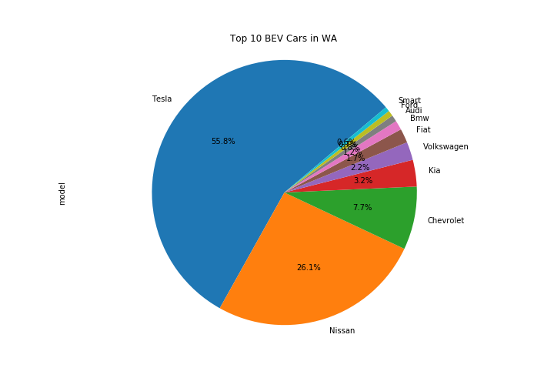
OUR STORY

Slide 6
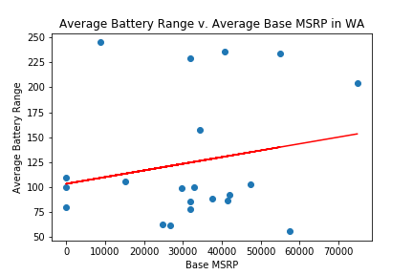
OUR STORY

Slide 7
Contact details
someone@example.com

